Slide 1
Demonstration of entanglement assisted invariance on IBM's quantum experience
Sebastian Deffner
Presented By Josie Burke, Robert Davis, and Leo Zheng

Slide 2
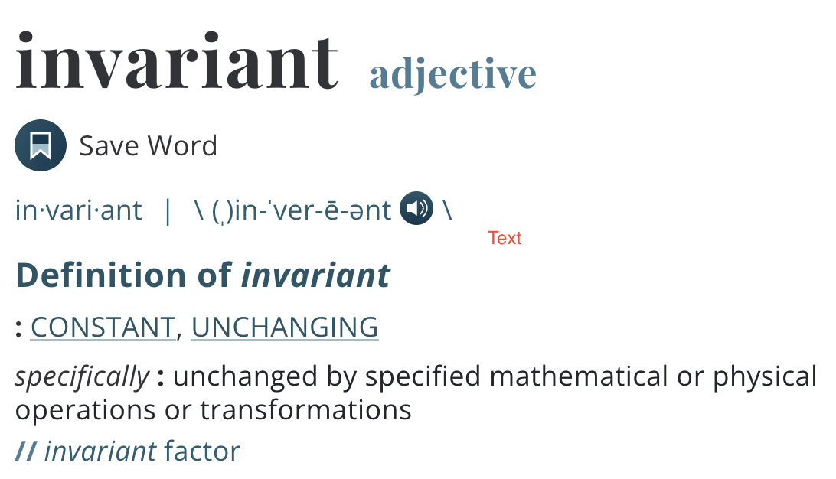
What is Invariance?
Notes:
Invariance is the idea that a property is conserved when some transformation is applied.

Slide 3
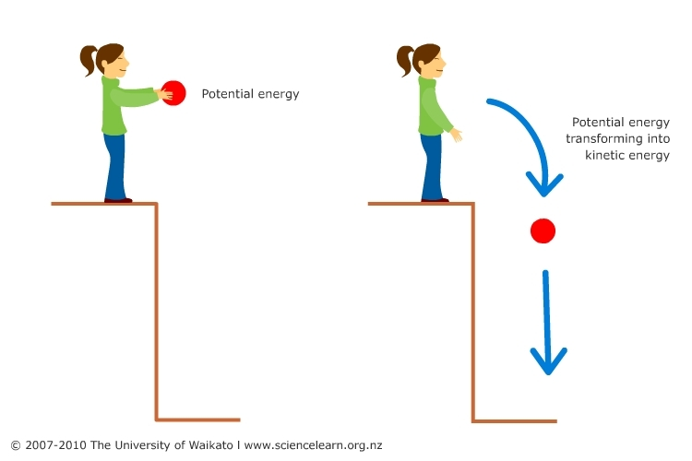
Invariance in the Context of Physics
Invariance is the idea that a property is conserved when some transformation is applied.
For example, the total energy of an isolated system is conserved. When looking at the universe as a closed system, this remains true. Energy is transformed, not destroyed or created.
Take the girl dropping the ball as an example, the law of conservation of energy states that energy can neither be created nor destroyed. As time progresses, the law of conservation of energy remains true. In other words, this law doesn’t vary as time goes on, thus we can say, that the law of conservation of energy is invariant in relation to time.

Slide 4
What is Envariance?
Envariance is just jargon. Envariance really means “environmentally assisted invariance”. This is the idea that the environment helps conserve the state of something. Like time in our previous example.
As Wojciech Hubert Zurek in “Environment-Assisted Invariance, Entanglement, and Probabilities in Quantum Physics” puts it
“A state of two coins (say, a penny and a cent) would be envariant when the first penny could be flipped, and then the cent ‘‘counterflipped,’’ so that the joint state is restored, i.e., no measurement on the system reveals any difference from the initial state. Pure (perfectly known) quantum states can exhibit this symmetry.
When measuring the result of invariant couples, no difference can be measured in their result. To enable or motivate envariance, a system must be entangled in a dynamically decoupled environment.

Slide 5
Dynamic Decoupling
We’ve explored multiple ways to reduce decoherence or mitigate the consequences, like repetition coding. One way is dynamic decoupling.
What is Dynamic Decoupling? Dynamic Decoupling reduces the system-environment interaction, which we know causes errors, to 0. It does this by using instantaneous, time oriented, control pulses to modify the environment around it.
In the context of quantum, in order for “envariance” to occur, the environment has negligible effects on the state of the qubit, such that the environmental risk of noise must be 0.

Slide 6
Symmetry and Envariance
Symmetry in physics is the idea that a part of a system remains preserved or unchanged in the face of some transformation. Take an apple for example, when I take a bite (transformation) out of the entire apple (system), the taste (part of the system) remains the same (preservation).
Envariance can be described as quantum symmetry. Where a part of system, weather it be the energy, momentum, or mass of an isolated system can’t be changed due to some specific transformation in respect to environment (time, charge, rotations, spatial inversion, or charge conjugation).
See full list of conserved state and their invariance here: http://www.cbooth.staff.shef.ac.uk/phy304/invariance.html

Slide 7
Putting It Together
What Were the Objectives?
Objective 1: The point of the paper is to demonstrate envariance through entanglement using IBM quantum experience.
  Data was collected through the use of IBM Quantum Experience
Objective 2: To demonstrate envariance in a quantum “universe” with five qubits rather than two. This experiment is meant to precede Quantum Optics’s, “technically challenging”, previous experiments, while demonstrating the usefulness and effectiveness of IBM’s cloud computing software, Quantum Experience.

Slide 8
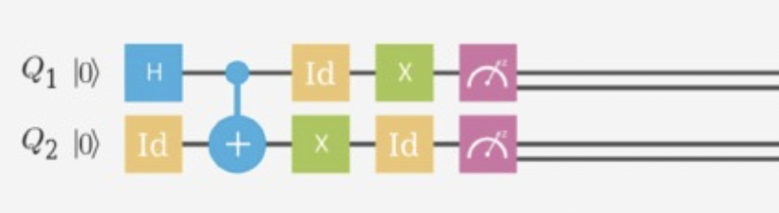
Experiment
Five experiments were conducted to demonstrate how today’s current quantum computers can entangle a limited amount of qubits
Through the use of the CNOT gate and this new idea of envariance, or quantum symmetry, we can develop quantum algorithms to entangle multiple qubits. The picture above shows just one way to achieve this.

Slide 9
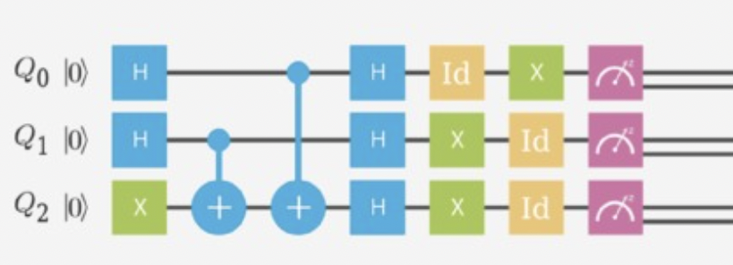
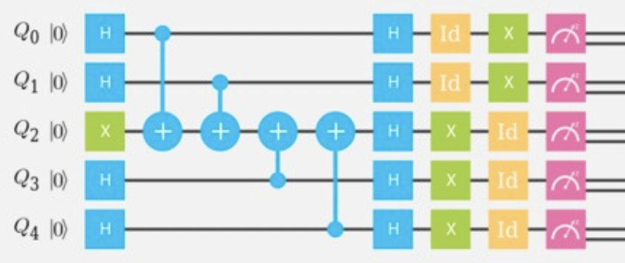
Adding qubits to the algorithm

Slide 10
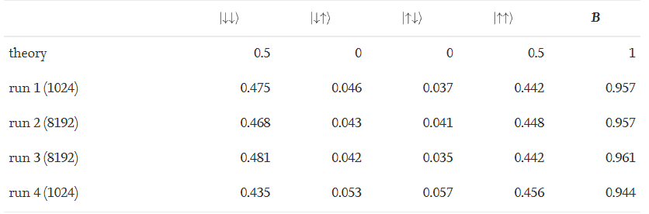
Results
The second qubit is more likely to “follow” along with the first qubit rather than “derailing” to the opposite state (no matter if it's in the initial or the “flipped” state) when entangled.
Will most of the time result in a double down |00> or a double up |11> rather than a mixture of opposite states ( |01> or |10>) when measured.

Slide 11
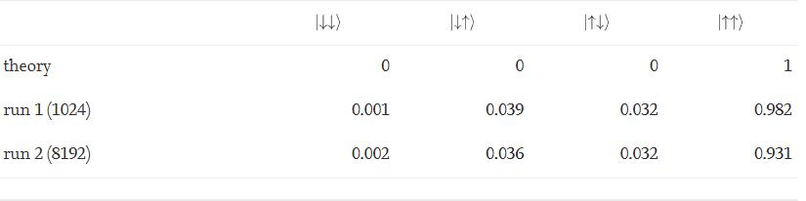
Results
When both qubits are “flipped” they are less likely to go back to their initial states when measured and are more likely to both stay on the “flipped” state because their states align with each other.

Slide 12
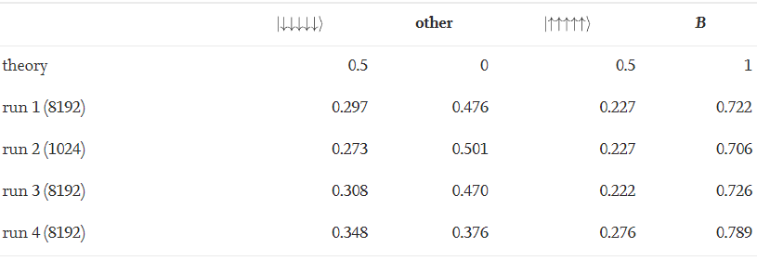
Results
This pattern of aligned entangled qubit states eventually stops once the testing of 5 entangled qubits have been reached.
This could have been the result of decoherence.

Slide 13
Significance
This research sheds light on to entanglement and evariance.
  These two properties are necessary for quantum advantage and computation, but are not yet completely understood and cannot be usefully implemented.
The experiment produces a basic algorithm for entanglement which can be improved upon and used for further research.
The limit of 5 qubits in this experiment shows the limitations of our current quantum computers.
  Because of this limitation, real quantum advantage still cannot be achieved.
This type of research and results could determine if IBM’s Quantum Experience is used in further research and work given its accuracy.

Slide 14
Downsides To This Experiment
Quality of the experimental outcome still lacks behind technically more challenging experiments in quantum optics. Despite having more qubits available over the cloud, Quantum Optics researchers achieved Bhattacharya coefficients (which measures the overlap of two samples, and subsequently the accuracy) of 99%, while Deffner, the author, only achieved 96%.
According to Deffner “Without direct access to and benchmarking of the experimental systems, experimentation is hardly feasible”.
Only projective measurements of the single qubit states in z-direction qubits can be performed, i.e., it can be measured whether the single qubits are in |↑〉or |↓〉. No quantum tomography (a method of producing a three-dimensional image of the internal structures of a solid object) for the joint state is available, which means that no direct measurements of correlations between qubits can be performed.
Notes:
This experiment mostly shows that there are many obstacles to cross before quantum advantage becomes plausible. However it touches on which quantum properties are necesary for an advantage, and demonstrates how we would utilize them

Slide 15
References
[1] Invariance Principles and Conservation Laws
[2] Environment-Assisted Invariance, Entanglement, and Probabilities in Quantum Physics
[3] Dynamical Decoupling a tutorial
[4] High fidelity quantum gates via dynamical decoupling
[5] Bhattacharya - an overview | ScienceDirect Topics
[6] Coherence of a dynamically decoupled single neutral atom
[7] Coherence of a dynamically decoupled single neutral atom

